Slide 1
Adversarial Machine Learning
What to do when things break because a malicious actor is fooling your model
Deep Learning – Assignment 3 – December 6th, 2022
Dinah Rabe, MDS 2023
Johannes Halkenhäußer, MDS 2023
Victor Möslein, MDS 2023
Benedikt Ströbl, MDS 2023

Slide 2




Do you really want to risk that?
Trained classifier
Adversary trying to fool the model
0.003 x
(noise imperceptible to human eye)
Classification model
Classification model
#hertielove

Slide 3
Concept
What do we mean by Adversarial ML?
Attacks
Different adversarial attacks and their mitigations
Examples
Real-world attacks, and how they could be avoided
Policies
Increasing challenge, missing policies

Slide 4
About Adversarial Machine Learning
Concept
Attacks
Examples
Policies
The concept, the issues, and how it can get dangerous

Slide 5





Introducing a new malicious actor to the normal machine learning process (1)
Concept
Attacks
Examples
Policies
adversarial
adjective
Involving actors opposing or disagreeing with each other
/ˌædvəˈseəriəl/
Different intend than Generative Adversarial Networks (GANs):
malicious versus co-operative
New Input Data
"Normal" Machine Learning Phases
Training Data
Algorithm Training
Predictive Model
Output (Prediction/Classification, etc.)
Sources:
All Icons are by The Noun Project

Slide 6



Introducing a new malicious actor to the normal machine learning process (2)
Concept
Attacks
Examples
Policies
Adversarial Attack Phases
Adverse Examples
ADVERSARY
New Input Data
Noise
Manipulate
Extract information
Training Data
Algorithm Training
Predictive Model
Wrong Output (Prediction/Classification, etc.)
Sources:
All Icons are by The Noun Project

Slide 7
The security of machine learning models is evaluated considering the goals and capabilities of the adversary
Concept
Attacks
Examples
Policies
The Attack Threat Model ¹ (adapted)
Classification of Adversarial Machine Learning attacks along three dimensions
Attack surface | Evasion attacks (testing/production phase)
 | Poisoning attacks (training phase)
 | Exploratory attacks (production phase)
Adversarial capabilities | Training phase | Data injection
 |  | Data modification
 |  | Logic corruption
 | Testing phase | White-box attacks
 |  | Black-box attacks
Adversarial goals | Confidence reduction
 | Mis-classification
 | Targeted mis-classification
 | Source/target mis-classification
 | Inference/Extraction
1. Evasion attack
Maliciously craft adjusted samples
Adversary has no influence over training data
e.g. bypassing SPAM filter
2. Poisoning attack
Inject bad data into training set
Model’s decision function gets manipulated
e.g. manipulate recommendation model on e-commerce platforms
3. Exploratory attack
Adversary has only black-box access to the model
Tries to infer knowledge about model or training data
e.g. re-identify patients in anonymized hospital records
Example 1 (next slides)
Example 2 (next slides)
Sources:
¹ Chakraborty, A., Alam, M., Dey, V., Chattopadhyay, A., & Mukhopadhyay, D. (2018). Adversarial attacks and defences: A survey. arXiv preprint arXiv:1810.00069.
² Kurakin, A., Goodfellow, I., & Bengio, S. (2016). Adversarial machine learning at scale. arXiv preprint arXiv:1611.01236.
³ Mehnaz, S., Dibbo, S. V., De Viti, R., Kabir, E., Brandenburg, B. B., Mangard, S., ... & Schneider, T. (2022). Are your sensitive attributes private? Novel model inversion attribute inference attacks on classification models.

Slide 8
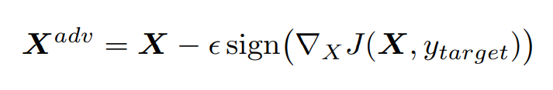

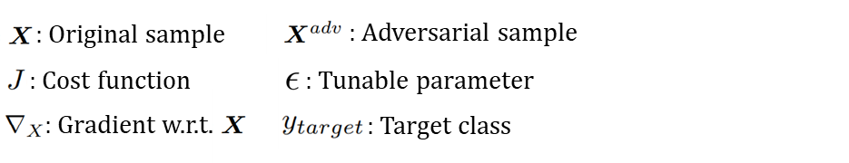
The security of machine learning models is evaluated considering the goals and capabilities of the adversary
Concept
Attacks
Examples
Policies
: Original sample
: Adversarial sample
: Cost function
: Tunable parameter
: Gradient w.r.t.
: Target class
Example attack 1: Target class method²
Evasion attack
White-box attack
Targeted mis-classification
Goal: Generate adversarial data samples to maximize the probability of mis-classification to a specific target class
Sources:
¹ Chakraborty, A., Alam, M., Dey, V., Chattopadhyay, A., & Mukhopadhyay, D. (2018). Adversarial attacks and defences: A survey. arXiv preprint arXiv:1810.00069.
² Kurakin, A., Goodfellow, I., & Bengio, S. (2016). Adversarial machine learning at scale. arXiv preprint arXiv:1611.01236.
³ Mehnaz, S., Dibbo, S. V., De Viti, R., Kabir, E., Brandenburg, B. B., Mangard, S., ... & Schneider, T. (2022). Are your sensitive attributes private? Novel model inversion attribute inference attacks on classification models.

Slide 9
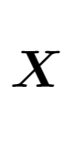
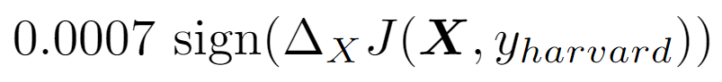
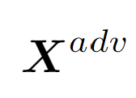
Example of Target Gradient Method evading our university entrance image classification model
Concept
Attacks
Examples
Policies
0.007 x
(Perturbation with target class method)
x
Classification model
Classification model

Slide 10
The security of machine learning models is evaluated considering the goals and capabilities of the adversary
Concept
Attacks
Examples
Policies
: Original sample
: Adversarial sample
: Cost function
: Tunable parameter
: Gradient w.r.t.
: Target class
Example attack 1: Target class method²
Evasion attack
White-box attack
Targeted mis-classification
Goal: Generate adversarial data samples to maximize the probability of mis-classification to a specific target class
Mitigation (e.g.): Generate perturbed samples and inject them into the training set to make your model more robust (Adversarial Training¹)
Sources:
¹ Chakraborty, A., Alam, M., Dey, V., Chattopadhyay, A., & Mukhopadhyay, D. (2018). Adversarial attacks and defences: A survey. arXiv preprint arXiv:1810.00069.
² Kurakin, A., Goodfellow, I., & Bengio, S. (2016). Adversarial machine learning at scale. arXiv preprint arXiv:1611.01236.
³ Mehnaz, S., Dibbo, S. V., De Viti, R., Kabir, E., Brandenburg, B. B., Mangard, S., ... & Schneider, T. (2022). Are your sensitive attributes private? Novel model inversion attribute inference attacks on classification models.

Slide 11
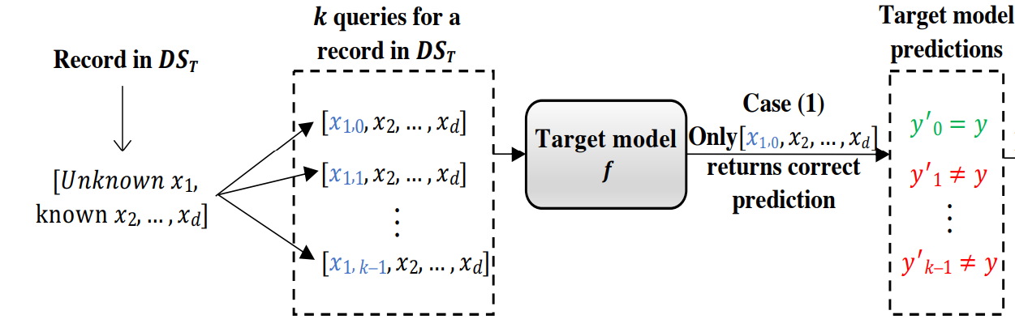
The security of machine learning models is evaluated considering the goals and capabilities of the adversary
Concept
Attacks
Examples
Policies
: Original sample
: Adversarial sample
: Cost function
: Tunable parameter
: Gradient w.r.t.
: Target class
Example attack 1: Target class method²
Example attack 2: Label-only model inference attack³
Evasion attack
White-box attack
Targeted mis-classification
Exploratory attack
Black-box attack
Inference/Extraction
Goal: Generate adversarial data samples to maximize the probability of mis-classification to a specific target class
Goal: Given black-box access to trained model and incomplete auxiliary information, infer sensitive attribute value
Attack:
(Mehnaz et al., 2022)
Mitigation (e.g.): Generate perturbed samples and inject them into the training set to make your model more robust (Adversarial Training¹)
Mitigation (e.g.): Do not return confidence scores of individual classes with model output but just the predicted label
Sources:
¹ Chakraborty, A., Alam, M., Dey, V., Chattopadhyay, A., & Mukhopadhyay, D. (2018). Adversarial attacks and defences: A survey. arXiv preprint arXiv:1810.00069.
² Kurakin, A., Goodfellow, I., & Bengio, S. (2016). Adversarial machine learning at scale. arXiv preprint arXiv:1611.01236.
³ Mehnaz, S., Dibbo, S. V., De Viti, R., Kabir, E., Brandenburg, B. B., Mangard, S., ... & Schneider, T. (2022). Are your sensitive attributes private? Novel model inversion attribute inference attacks on classification models.

Slide 12
Adversarial Attacks in the Wild
Concept
Attacks
Examples
Policies
When things went south and how it could have been avoided

Slide 13



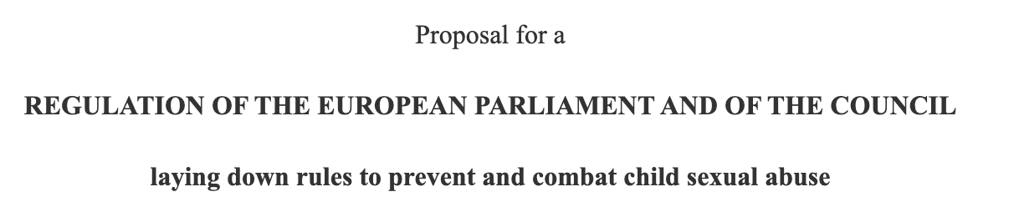

Concept
Attacks
Examples
Policies
Real-world risks are posed by adversarial techniques when deploying ML in policy solutions (1)
Example 1: Combatting sexual abusive content
Possible Countermeasures²
Using basis function transformations
Adversarial Training
Defensive Distillation
Feature Squeezing
MagNet
Defense GAN
Gradient Hiding
Blocking the Transferability
Using high-level representation guided denoiser
The EU Commission wants to prevent the spread of images and videos showing child abuse in End-To-End Encryption Environments
Proposal Hashing-Based Client-Side Scanning
Problem: Adversarial Attacks can be used to avoid detection¹
Side question: Ethical to publish papers about ways people can attacks models?
Solution either of technical nature or in countermeasures to adversarial attacks
Sources:
¹ Jain, S., Crețu, A. M., & de Montjoye, Y. A. (2022). Adversarial Detection Avoidance Attacks: Evaluating the robustness of perceptual hashing-based client-side scanning. In 31st USENIX Security Symposium (USENIX Security 22) (pp. 2317-2334).
² Chakraborty, A., Alam, M., Dey, V., Chattopadhyay, A., & Mukhopadhyay, D. (2018). Adversarial attacks and defences: A survey. arXiv preprint arXiv:1810.00069.

Slide 14
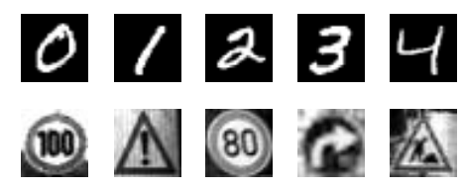
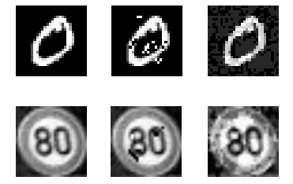
Concept
Attacks
Examples
Policies
Real-world risks are posed by adversarial techniques when deploying ML in policy solutions (2)
Example 2:
Traffic Sign Detection Evasion¹
Evasion attacks noise or blurring
Sources:
¹ Hosseini, H., Chen, Y., Kannan, S., Zhang, B., & Poovendran, R. (2017). Blocking transferability of adversarial examples in black-box learning systems. arXiv preprint arXiv:1703.04318.

Slide 15
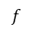
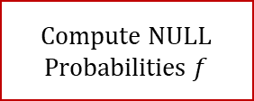
Concept
Attacks
Examples
Policies
Real-world risks are posed by adversarial techniques when deploying ML in policy solutions (2)
Example 2:
Traffic Sign Detection Evasion¹
Countermeasure:
NULL-labeling
Training Data
Initial Training
Parameters
Architecture
Validation Data
Compute NULL Probabilities $f$
Evasion attacks noise or blurring
$f$
Training Data
Adversarial Training
Parameters
Sources:
¹ Hosseini, H., Chen, Y., Kannan, S., Zhang, B., & Poovendran, R. (2017). Blocking transferability of adversarial examples in black-box learning systems. arXiv preprint arXiv:1703.04318.

Slide 16
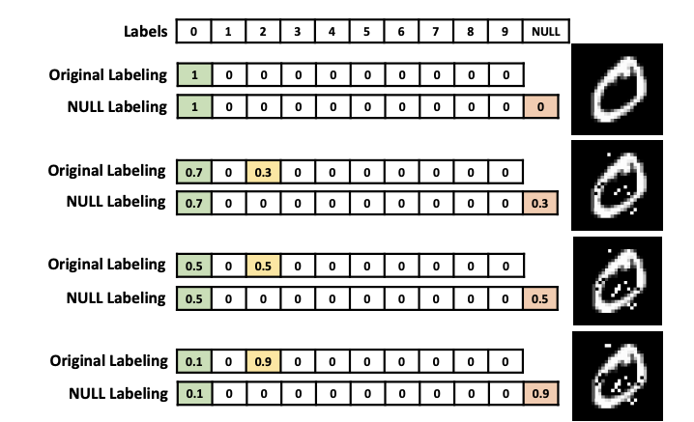
Concept
Attacks
Examples
Policies
Real-world risks are posed by adversarial techniques when deploying ML in policy solutions (2)
Example 2:
Traffic Sign Detection Evasion¹
Countermeasure:
NULL-labeling
NULL-labeling output
Training Data
Initial Training
Parameters
Architecture
Validation Data
Compute NULL Probabilities $f$
Evasion attacks noise or blurring
$f$
Training Data
Adversarial Training
Parameters
(Hosseini et al., 2017)
Sources:
¹ Hosseini, H., Chen, Y., Kannan, S., Zhang, B., & Poovendran, R. (2017). Blocking transferability of adversarial examples in black-box learning systems. arXiv preprint arXiv:1703.04318.

Slide 17

Current policy approaches fail to counteract the rising risk of Adversarial Machine Learning
Concept
Attacks
Examples
Policies
Increasing challenge of AML
Industry reports urgent need for better protection of ML systems against adversarial attacks¹
“Application leaders must anticipate and prepare to mitigate potential risks of data corruption, model theft, and adversarial samples“ – Gartner 2019
Google, Microsoft and others launched initiatives to protect their ML systems, in additional to existing defenses of software
What is the role of policy-makers?
Sources:
¹ R. S. Siva Kumar et al., "Adversarial Machine Learning-Industry Perspectives," 2020 IEEE Security and Privacy Workshops (SPW), 2020, pp. 69-75, doi: 10.1109/SPW50608.2020.00028.
² European Commission, “Ethics guidelines for trustworthy AI,” 2019, https://digital-strategy.ec.europa.eu/en/library/ethics-guidelines-trustworthy-ai
³ European Commission, “Artificcial Intelligence Act”, 2021, https://eur-lex.europa.eu/legal-content/EN/TXT/HTML/?uri=CELEX:52021PC0206&from=EN
⁴ Chakraborty, A., Alam, M., Dey, V., Chattopadhyay, A. and Mukhopadhyay, D. (2021), A survey on adversarial attacks and defences. CAAI Trans. Intell. Technol, 6: 25-45. https://doi.org/10.1049/cit2.12028

Slide 18


Current policy approaches fail to counteract the rising risk of Adversarial Machine Learning
Concept
Attacks
Examples
Policies
Increasing challenge of AML
Current legislative approaches
Industry reports urgent need for better protection of ML systems against adversarial attacks¹
Governments are showing first signs that industry will have to build ML systems more securely and robust to adversarial attacks
The EU published ethics guidelines for trustworthy AI in 2019²
“Application leaders must anticipate and prepare to mitigate potential risks of data corruption, model theft, and adversarial samples“ – Gartner 2019
“AI systems need to be resilient and secure” and have a “fall back plan in case something goes wrong”
Google, Microsoft and others launched initiatives to protect their ML systems, in additional to existing defenses of software
The EU AI Act specifically addresses the risks of AML³
Providers of high-risk AI must ensure “where appropriate measures to prevent and control” adversarial attacks
What is the role of policy-makers?
Sources:
¹ R. S. Siva Kumar et al., "Adversarial Machine Learning-Industry Perspectives," 2020 IEEE Security and Privacy Workshops (SPW), 2020, pp. 69-75, doi: 10.1109/SPW50608.2020.00028.
² European Commission, “Ethics guidelines for trustworthy AI,” 2019, https://digital-strategy.ec.europa.eu/en/library/ethics-guidelines-trustworthy-ai
³ European Commission, “Artificcial Intelligence Act”, 2021, https://eur-lex.europa.eu/legal-content/EN/TXT/HTML/?uri=CELEX:52021PC0206&from=EN
⁴ Chakraborty, A., Alam, M., Dey, V., Chattopadhyay, A. and Mukhopadhyay, D. (2021), A survey on adversarial attacks and defences. CAAI Trans. Intell. Technol, 6: 25-45. https://doi.org/10.1049/cit2.12028

Slide 19

Current policy approaches fail to counteract the rising risk of Adversarial Machine Learning
Concept
Attacks
Examples
Policies
Increasing challenge of AML
Current legislative approaches
Policies needed
Industry reports urgent need for better protection of ML systems against adversarial attacks¹
Governments are showing first signs that industry will have to build ML systems more securely and robust to adversarial attacks
It is however unclear how providers of AI systems can comply with such regulation
The EU published ethics guidelines for trustworthy AI in 2019²
“It remains as an open problem for the ML community to come up with a considerably robust design against these adversarial attacks.” ⁴
“Application leaders must anticipate and prepare to mitigate potential risks of data corruption, model theft, and adversarial samples“ – Gartner 2019
“AI systems need to be resilient and secure” and have a “fall back plan in case something goes wrong”
Google, Microsoft and others launched initiatives to protect their ML systems, in additional to existing defenses of software
The EU AI Act specifically addresses the risks of AML³
Policies must acknowledge that it is still impossible to build fully secure ML systems, but demand development and use of tools to protect data, models and infrastructure
Providers of high-risk AI must ensure “where appropriate measures to prevent and control” adversarial attacks
What is the role of policy-makers?
Sources:
¹ R. S. Siva Kumar et al., "Adversarial Machine Learning-Industry Perspectives," 2020 IEEE Security and Privacy Workshops (SPW), 2020, pp. 69-75, doi: 10.1109/SPW50608.2020.00028.
² European Commission, “Ethics guidelines for trustworthy AI,” 2019, https://digital-strategy.ec.europa.eu/en/library/ethics-guidelines-trustworthy-ai
³ European Commission, “Artificcial Intelligence Act”, 2021, https://eur-lex.europa.eu/legal-content/EN/TXT/HTML/?uri=CELEX:52021PC0206&from=EN
⁴ Chakraborty, A., Alam, M., Dey, V., Chattopadhyay, A. and Mukhopadhyay, D. (2021), A survey on adversarial attacks and defences. CAAI Trans. Intell. Technol, 6: 25-45. https://doi.org/10.1049/cit2.12028

Slide 20
Prevent. Lose. Improve.
Introducing our tutorial illustrating the never-ending attack cycle

Slide 21
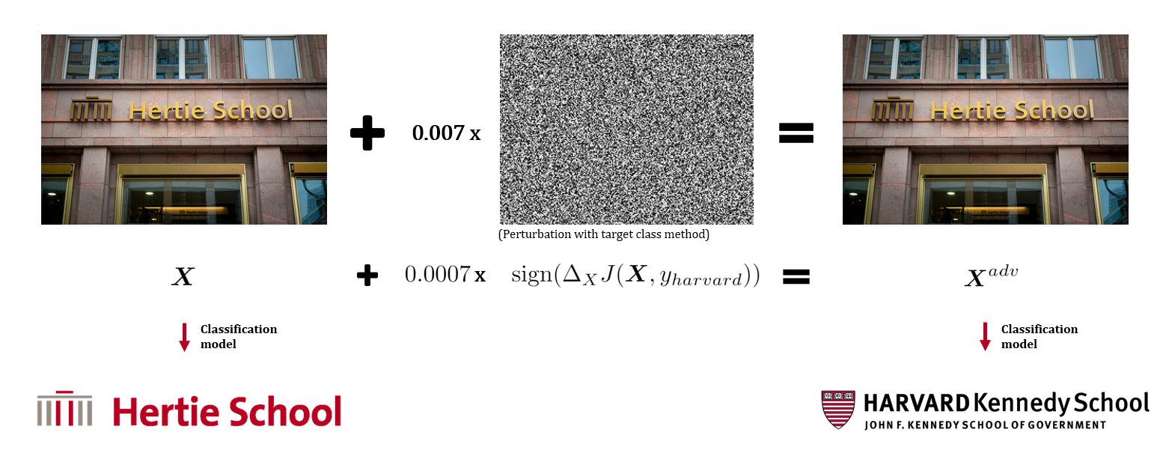
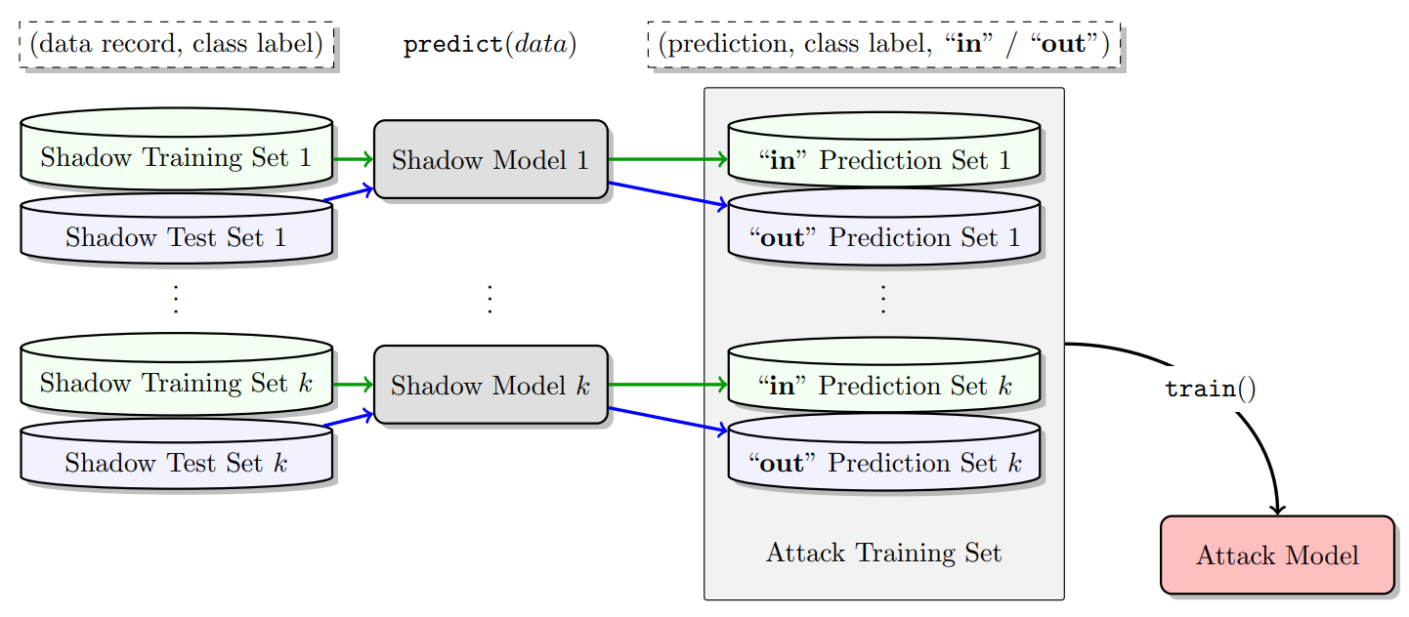
Become an adversary yourself – implementing two exemplary attacks with mitigation strategies
1. Evasion attack: Target class method¹
Get to know the structure of the introductory example of this presentation in practice
Implement the Target class method yourself
Find out how effective simple mitigation strategies can be
2. Exploratory attack: Membership inference²
Assuming black-box access to a classification model
Engineer your very own attack to infer whether a sample was part of the training set or not
What could be an effective defense mechanism against this type of attack?
(Shokri et al., 2017)
Sources:
¹ Kurakin, A., Goodfellow, I., & Bengio, S. (2016). Adversarial machine learning at scale. arXiv preprint arXiv:1611.01236.
² Shokri, R., Stronati, M., Song, C., & Shmatikov, V. (2017, May). Membership inference attacks against machine learning models. In 2017 IEEE symposium on security and privacy (SP) (pp. 3-18). IEEE.

Slide 22
Further Learning Resources
Curated list of resources that we think are helpful for guided self-studying

Slide 23
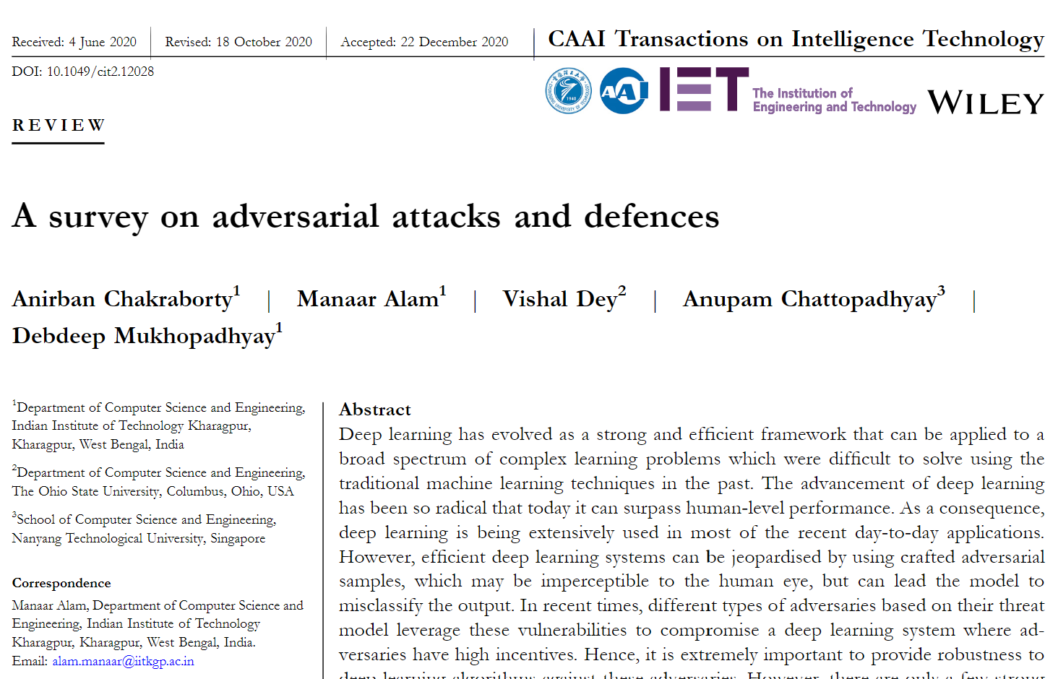
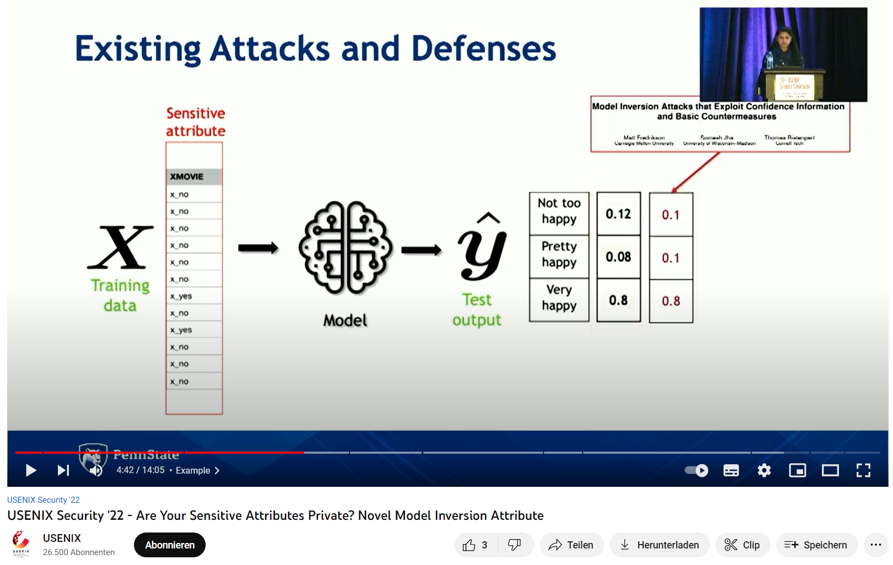
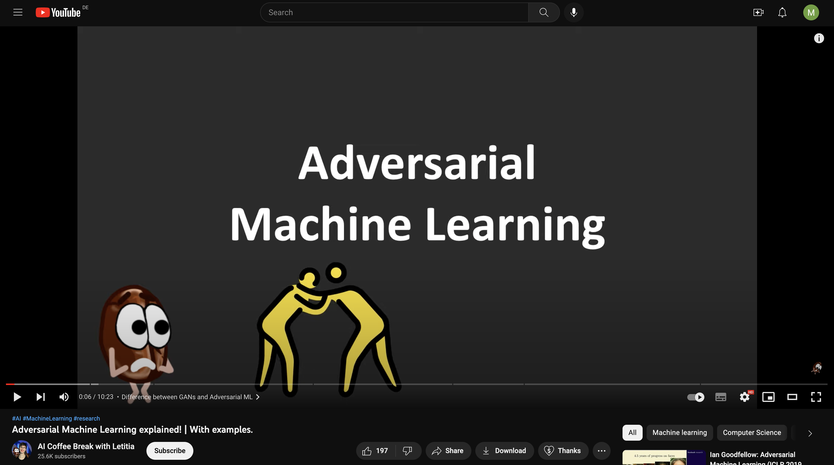
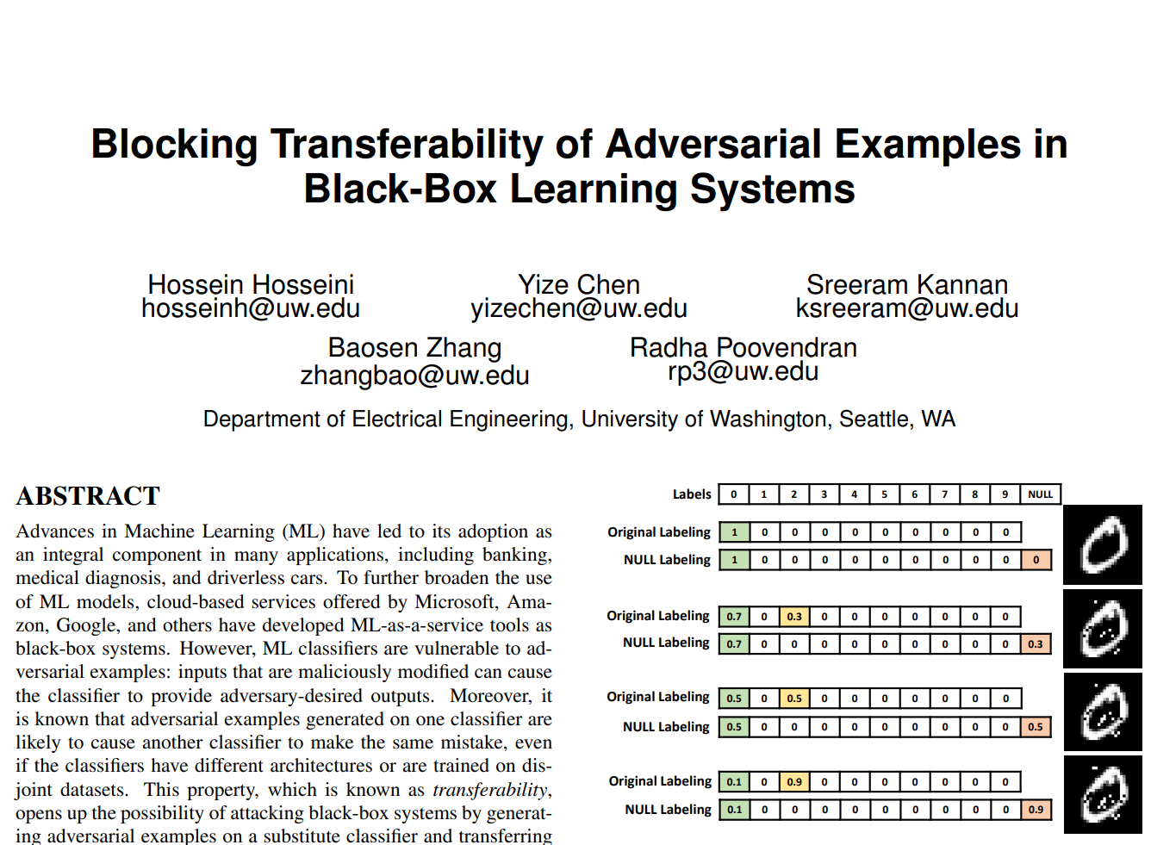
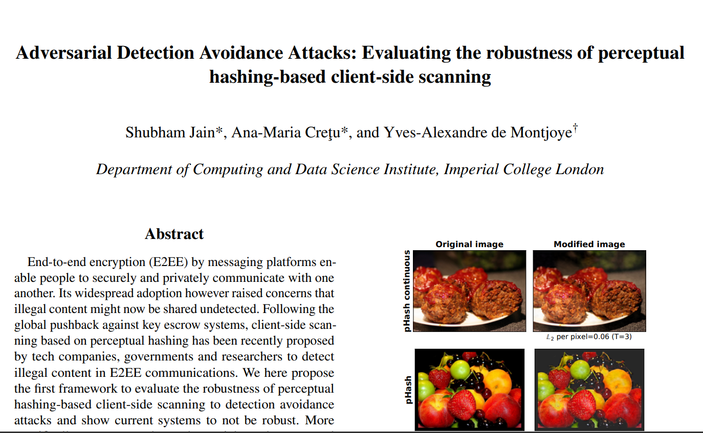
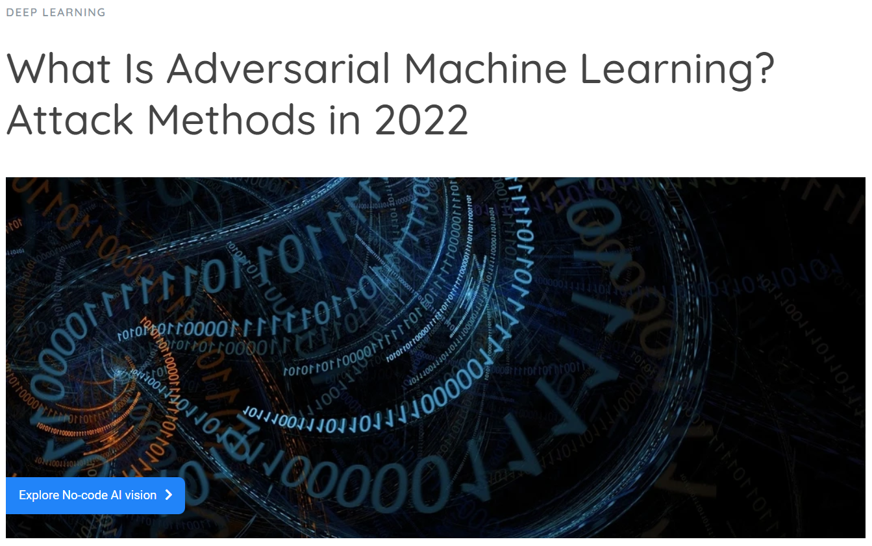
Further Learning Resources
Short Introduction Video
Great survey of the field
Introduction of the LOMIA model
NULL-labeling mitigation strategy
Assessment of EU’s proposal w.r.t. child abuse
Viso.ai article giving overview of attack types

Slide 24
References
The resources we cited throughout this presentation

Slide 25
References
Jain, S., Crețu, A. M., & de Montjoye, Y. A. (2022). Adversarial Detection Avoidance Attacks: Evaluating the robustness of perceptual hashing-based client-side scanning. In 31st USENIX Security Symposium (USENIX Security 22) (pp. 2317-2334).
Chakraborty, A., Alam, M., Dey, V., Chattopadhyay, A., & Mukhopadhyay, D. (2018). Adversarial attacks and defences: A survey. arXiv preprint arXiv:1810.00069.
Hosseini, H., Chen, Y., Kannan, S., Zhang, B., & Poovendran, R. (2017). Blocking transferability of adversarial examples in black-box learning systems. arXiv preprint arXiv:1703.04318.
Kurakin, A., Goodfellow, I., & Bengio, S. (2016). Adversarial machine learning at scale. arXiv preprint arXiv:1611.01236.
Fredrikson, M., Lantz, E., Jha, S., Lin, S., Page, D., & Ristenpart, T. (2014). Privacy in pharmacogenetics: An {End-to-End} case study of personalized warfarin dosing. In 23rd USENIX Security Symposium (USENIX Security 14) (pp. 17-32).
Mehnaz, S., Dibbo, S. V., De Viti, R., Kabir, E., Brandenburg, B. B., Mangard, S., ... & Schneider, T. (2022). Are your sensitive attributes private? Novel model inversion attribute inference attacks on classification models. In 31st USENIX Security Symposium (USENIX Security 22) (pp. 4579-4596).
Pauling, C., Gimson, M., Qaid, M., Kida, A., & Halak, B. (2022). A Tutorial on Adversarial Learning Attacks and Countermeasures. arXiv preprint arXiv:2202.10377.
Shokri, R., Stronati, M., Song, C., & Shmatikov, V. (2017, May). Membership inference attacks against machine learning models. In 2017 IEEE symposium on security and privacy (SP) (pp. 3-18). IEEE.

